Slide 1
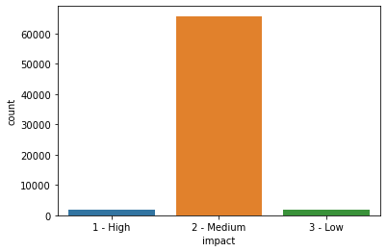
1. Case study goals
Business goal: predict the impact of the incident raised by the customers.
POC goal: to build a machine learning model that predicts accurately the incidents with high impact
2. Dataset highlights*
Missing values treatment
Target variable
Target values percentage:
High: 2.25%
Medium: 95%
Low: 2.75%
We deal with imbalanced classes.
Based on missing value percentage:
Less than 5% (ID_caller, opened_by, location, category_ID) : mode imputation
Between 5% and 40% (created_by, user_symptom, support_incharge): special label
Greater than 40% (problem_ID, change_request): drop
*We have split the data set into train and test set before starting our analysis and modeling. Therefore, the information that we present is from the training set. The missing value imputation and feature engineering on the test set has been based on the data from the training set.

Slide 2
3. Exploratory Data Analysis
Data Analysis - findings
Feature engineering
Incidents (all types) are more likely to occur:
  in the period march – may
  in the first four days of the week
  during the working hours (8-16)
  In Location 204, 161 and 143
  Under incident identifier ID INC0019396 and Caller 1904
Most of the incidents (all types):
  were reported by identifier 17 (opened by 17)
  were registered by unidentified users (i.e. missing value)
  had the description 491 from the user (user symptom 491)
  had the category IDs either 46,26,53 or 42 (description of the affected service)
  had the identifier of the support group 70
  had unidentified user in charge
  did not have a notification
  did not have document knowledge and confirmation check (were not double checked) indicators
extracted from open time: month, day of week and hour of day
encoded the boolean columns (active) with labels (False – 0, True – 1)
One Hot Encoding for categorical variables (ID_status, location, user_symptom)
The other variables have been dropped.
Approach
As the target label has 3 values (low, medium, high) – we have a multi classification problem. Because the low class has very few values, we can:
Use a multi-classification approach OR
We can regroup the low and medium classes into a single one and use a binary classification approach
Because of this particularity, we will follow the second approach.
We will not include in our model data t

Slide 3
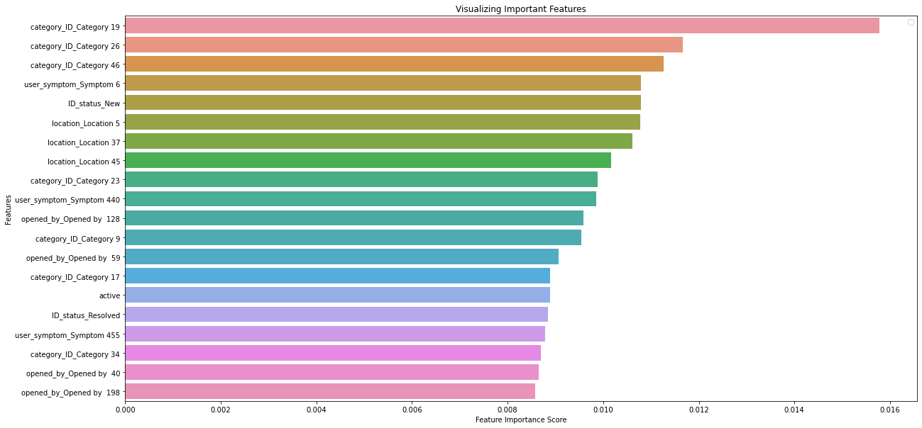
4. Results
Interpretation:
Precision: correctly classifies the incidents 82% of the time
Recall: correctly classifies the not high incidents 82% of the time
F1 score: is “accurate” 82% of the time
The model we used to predict the impact of the incidents was XGBoost Classifier.
Top 20 most important features (out of 245)
There is always room for improvement (performance and reducing overfitting):
Try over- or under-sampling techniques to improve the model’s performance
Modify the decision threshold for classification
use other ML models
Benefits of ML approach:
The automatic assignment of the impact will:
  reduce the manual work (no more manual assignment of the incidents)
  reduce the resolution time (the time spent on identifying the impact can be used to solve the issue)
  Improve the efficiency of the IT team overall (it can be possible to also assign a team/person automatically once the impact of the incident is established)
Performance of the model*
 | Precision | Recall | F1 score
Train | 0.95 | 1 | 0.98
Test | 0.82 | 0.82 | 0.82
*The metrics were calculated for the high class.

